Slide 1
1. INTRODUCTION
1.1 OVERVIEW
Meaning of political analysis?
political analysis is the understanding of political actions for
LOK SABHA 2019
LINK:
1. https://github.com/ponselvi2003/political_juggernauts-
NM2023TMID02655
2. http://public.tableau.com/app/profile/pappu.m2650/vizzes
CONTENT
Content analysis involves systematic study of messages conveyed in natural language text. In political research for LOK SABHA ANALYSIS 2019

Slide 2
2. purpose
policy Analysis is the process of identifying potential policy options that could address yours problems and then comparing those options to choose the most effective,efficient,and feasible one.
1.3 ADVANTAGE & DISADVANTAGE
Its helps raise good citizens and good leaders.
methodological issues and people rely so much on technoloy that their physical health is affected.

Slide 3
3. POLITICAL JUGGERNAUTS
A Quantative Analysis of candidates in the 2019 Lok Sabha Elections

Slide 4
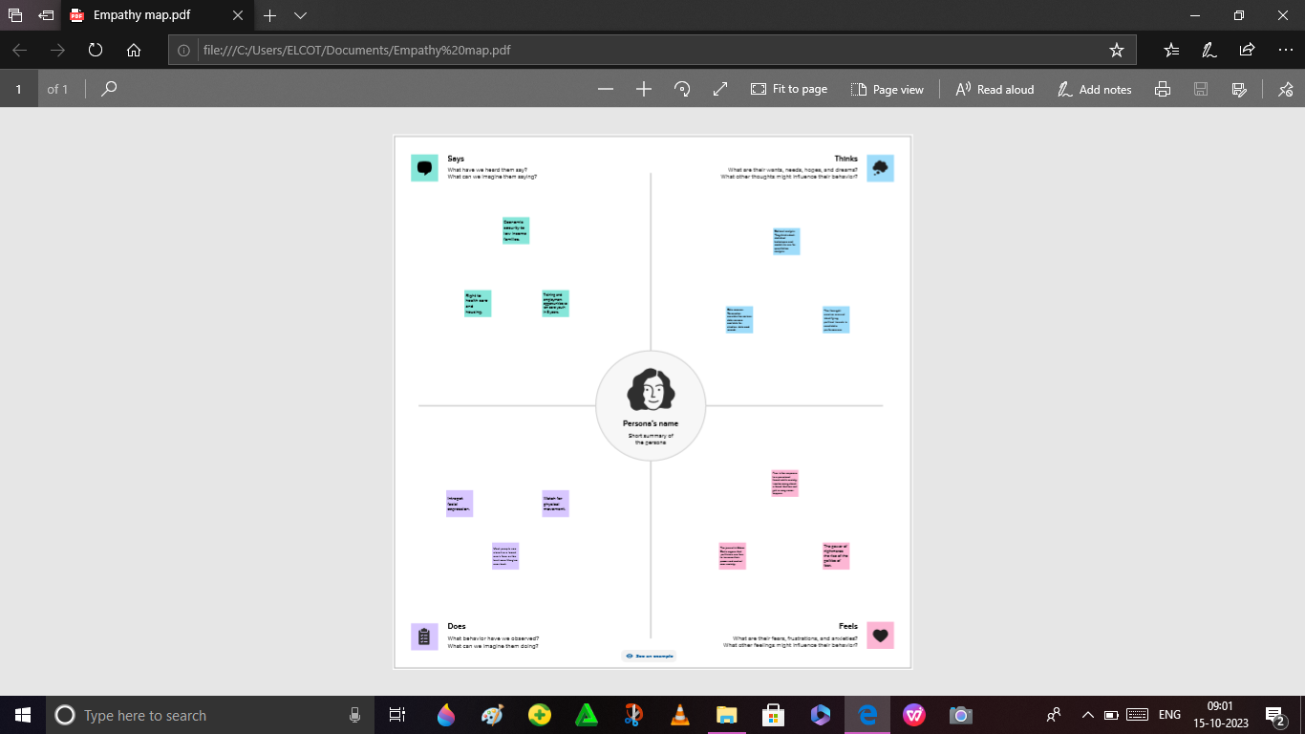
4. Empathy map
step 1- downloaded the MURAL app
sign in
group title -POLITICAL JUGGERNAUTS
created the project with teamwork
created the empathy map used to MURAL app

Slide 5
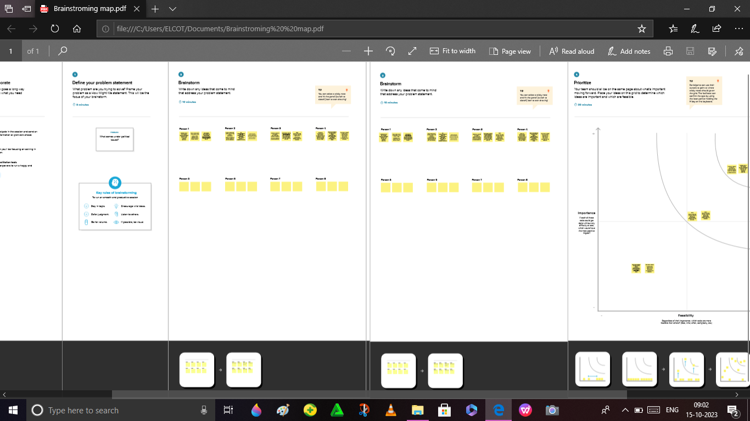
5.Brainstorming map
created to the Brainstorming map
used by MURAL app with team work

Slide 6
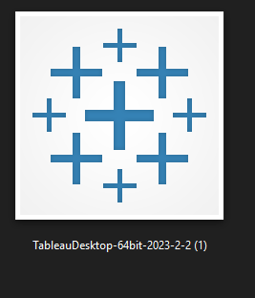
6.Tableau Desktop
Downloaded the Tableau Desktop app (0nly 14 days)
Then , the group title is POLITICAL JUGGERNAUTS AND ANALYSIS
created the project with team

Slide 7
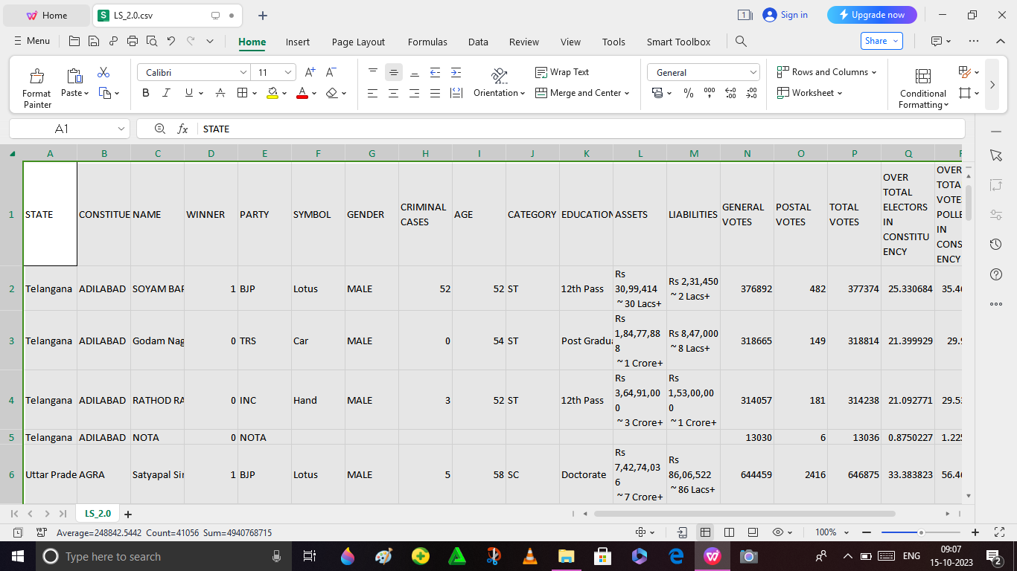
7. DATASET
collected the DATASET
Edited the DATASET
It is used for project creating

Slide 8
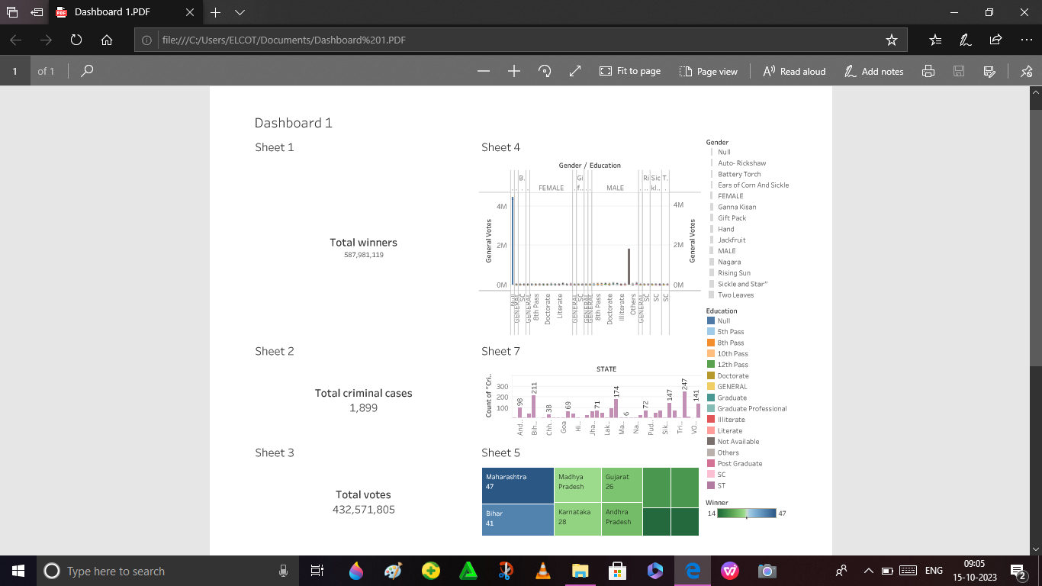
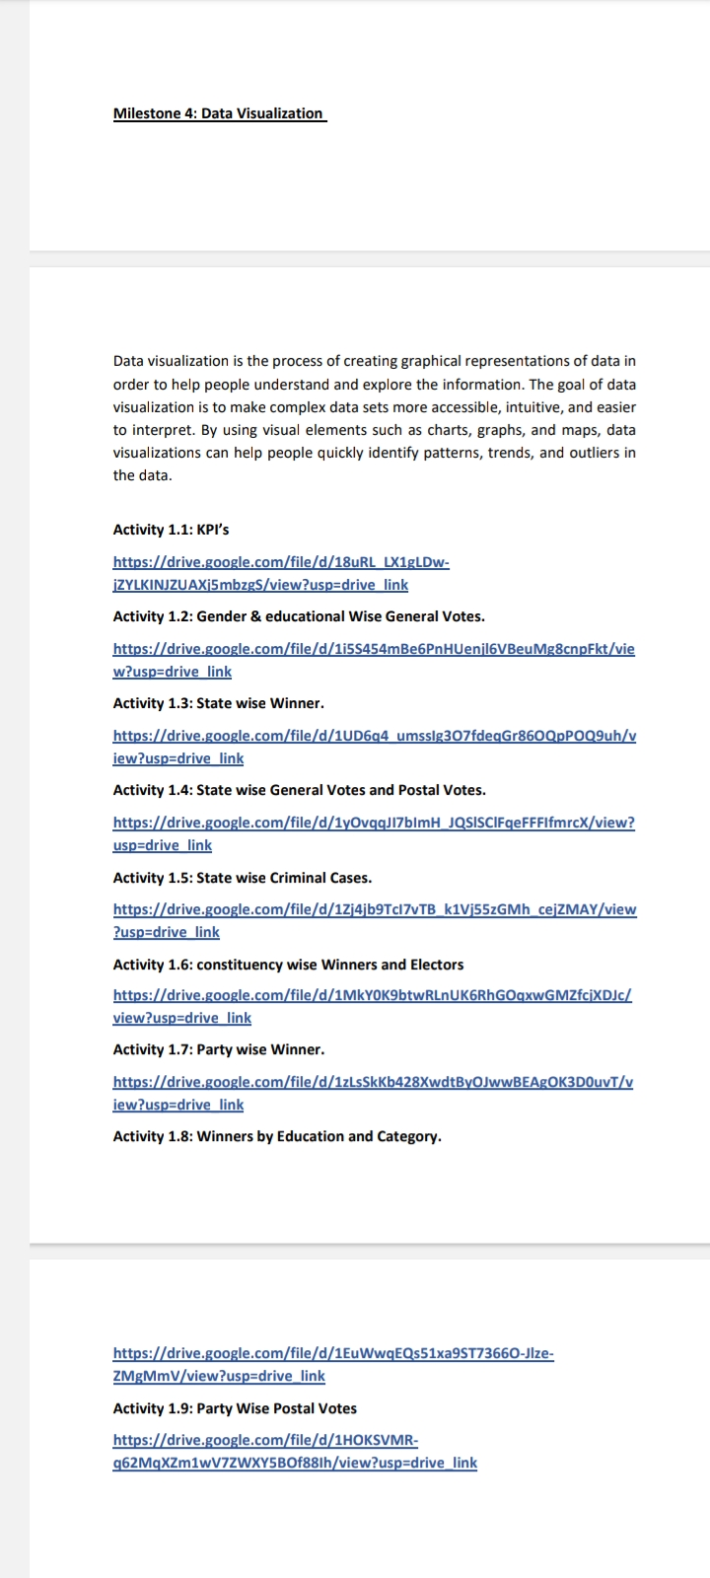
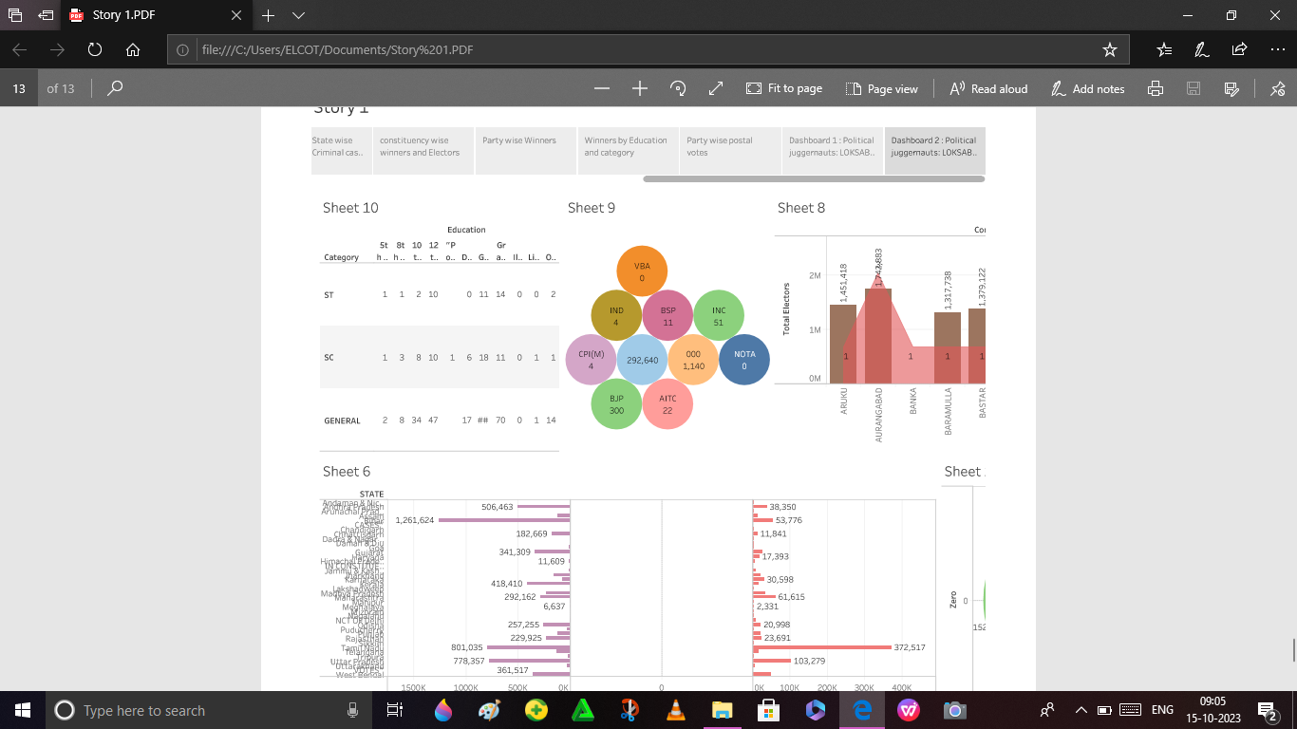
8. PROJECTS
USED TO THE LINKS TO HOW TO CREAED THE PROJECTS
IT IS DATA VISUALIZATION PROJECTS

Slide 9
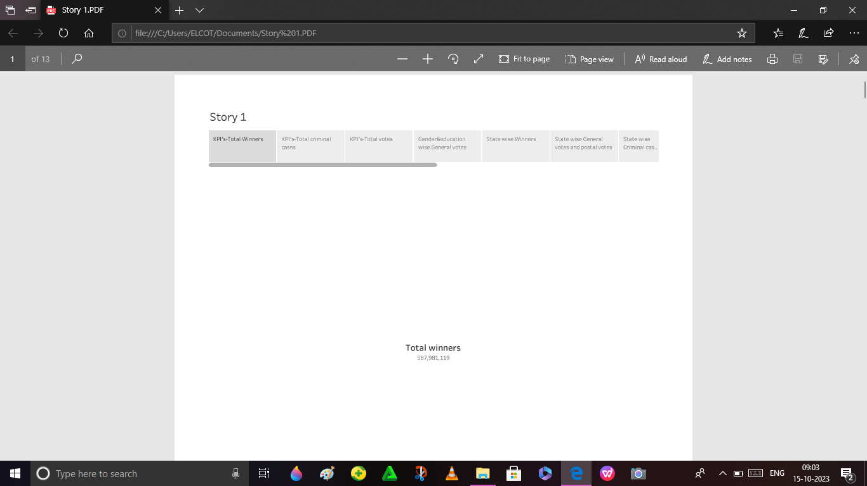
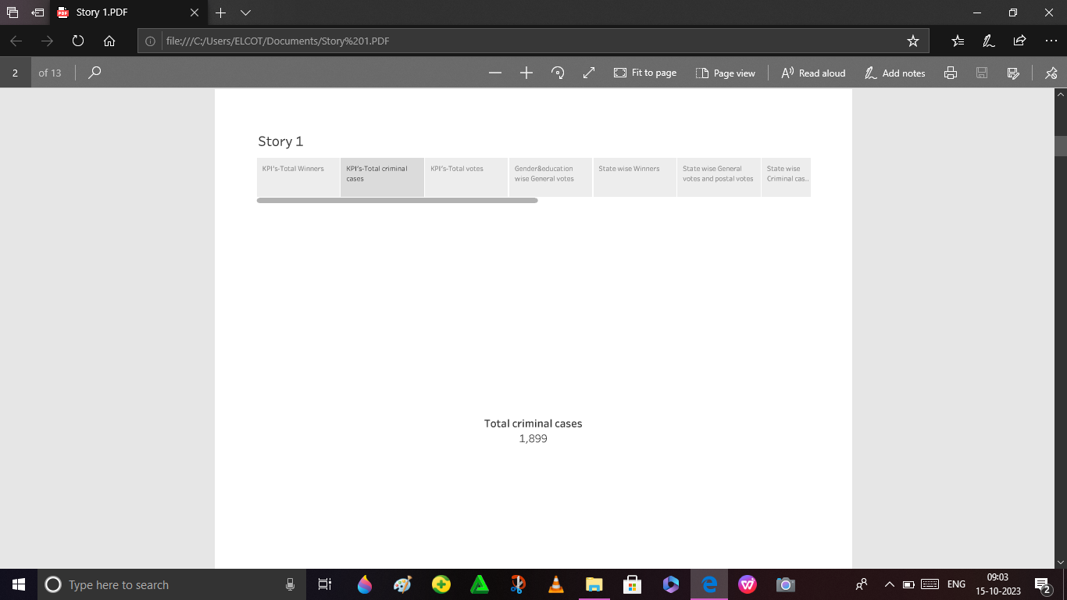
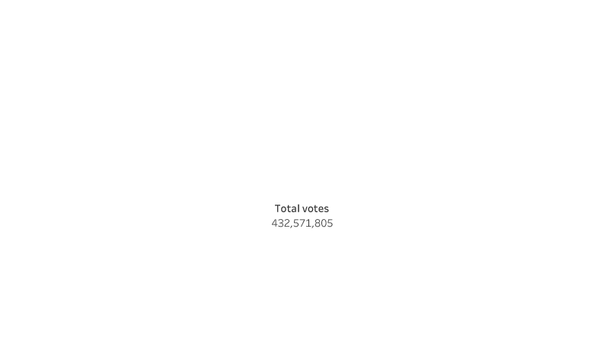
9.VISUALIZATION’S
Activity 1: KPI’S

Slide 10
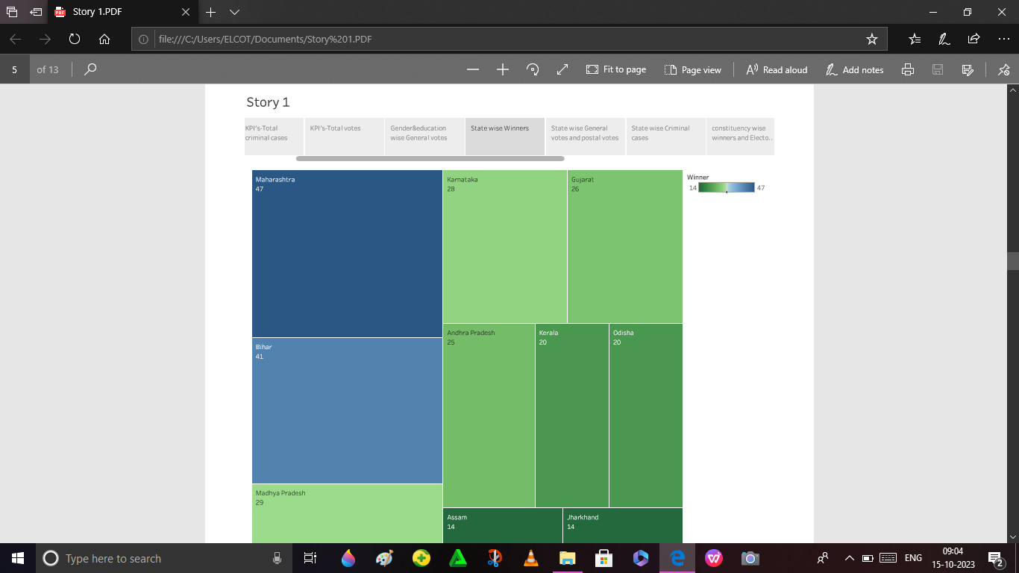
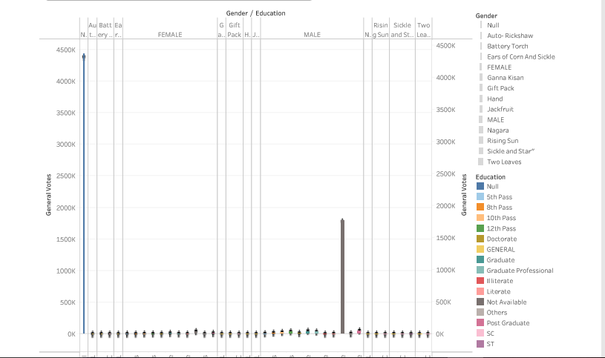
VISUALIZATION
Activity 2
Activity 3
Gender & education wise General votes
State wise Winners

Slide 11
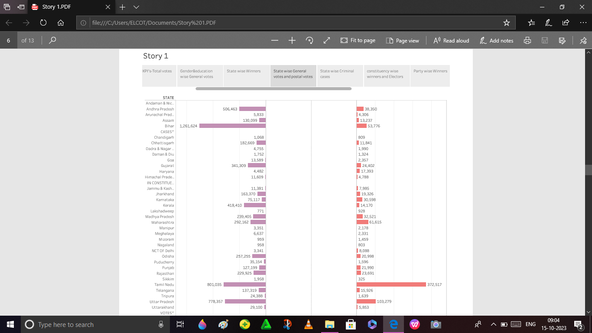
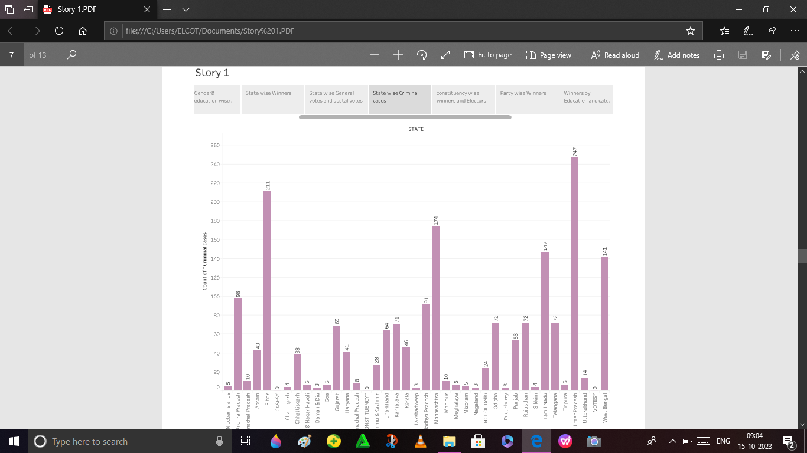
VISUALIZATION
Activity : 4
Activity : 5
State wise General Votes and
Postal votes
State Wise Criminal Cases

Slide 12
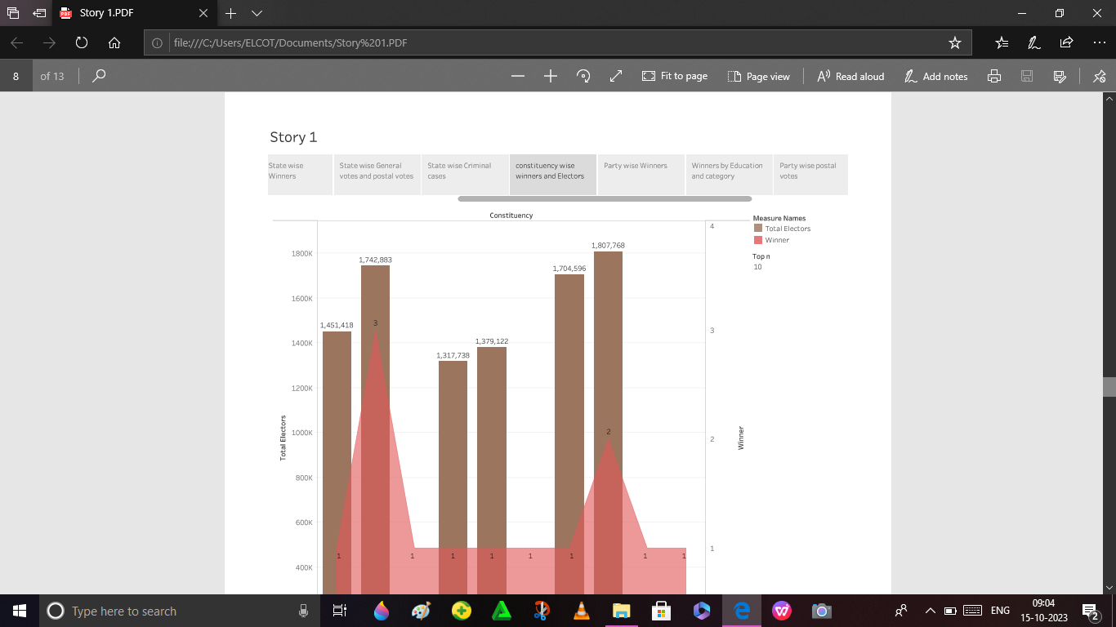
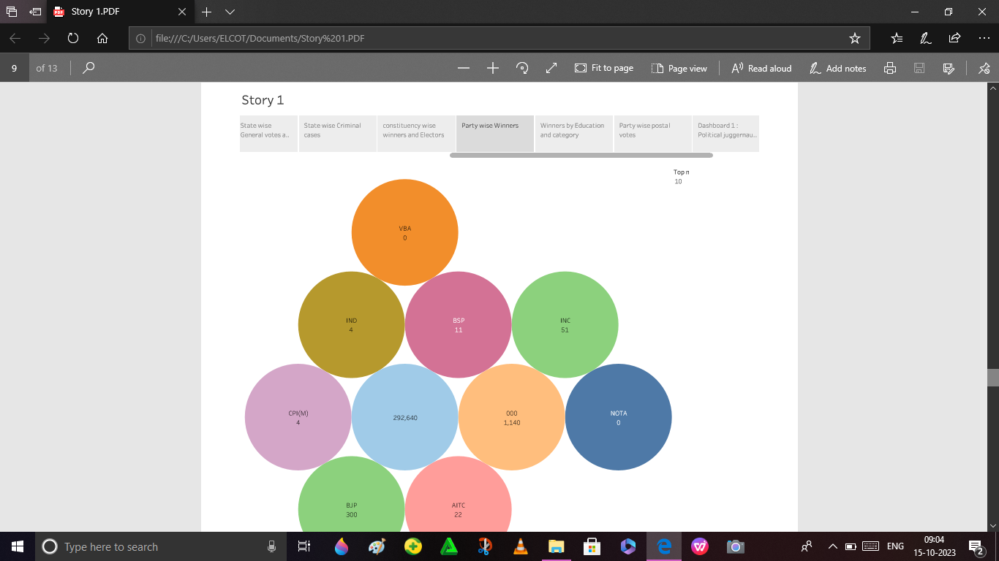
VISUALIZATION
Activity : 6
Activity : 7
Constituency wise Winners and Electors
Party wise Winners

Slide 13
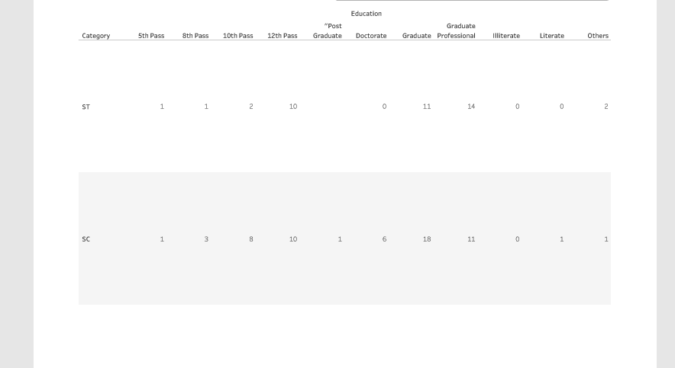
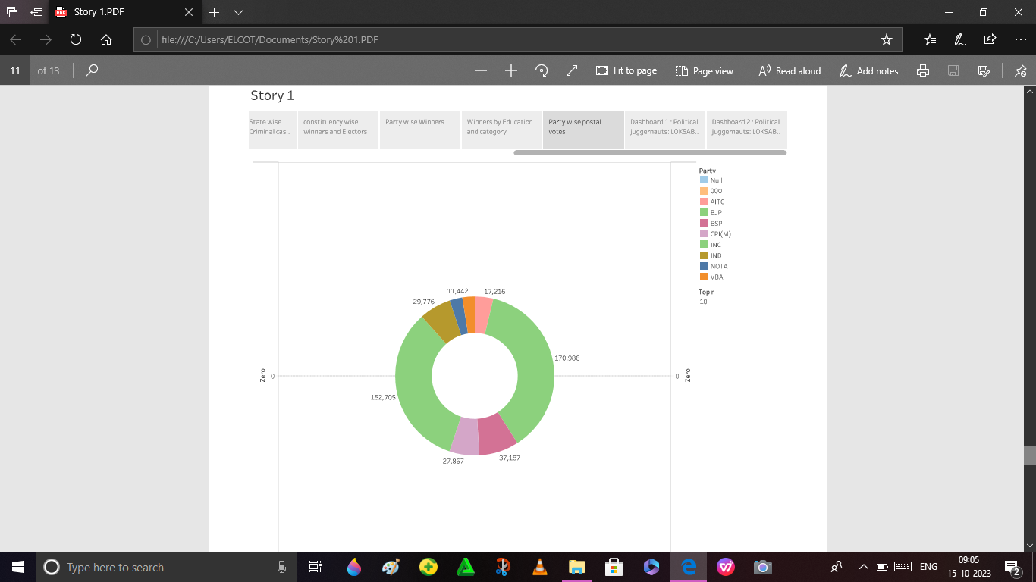
VISUALIZATION
Activity : 8
Activity : 9
Winners by Education and Category
Party Wise Posral Votes

Slide 14
10. DESIGN OF DASHBOARD
Dashboard 1
Dashboard 2
open the dashboard 1 then
selected the sheets below six and edit
open the dashboard 2 and selected the sheets and edit

Slide 15
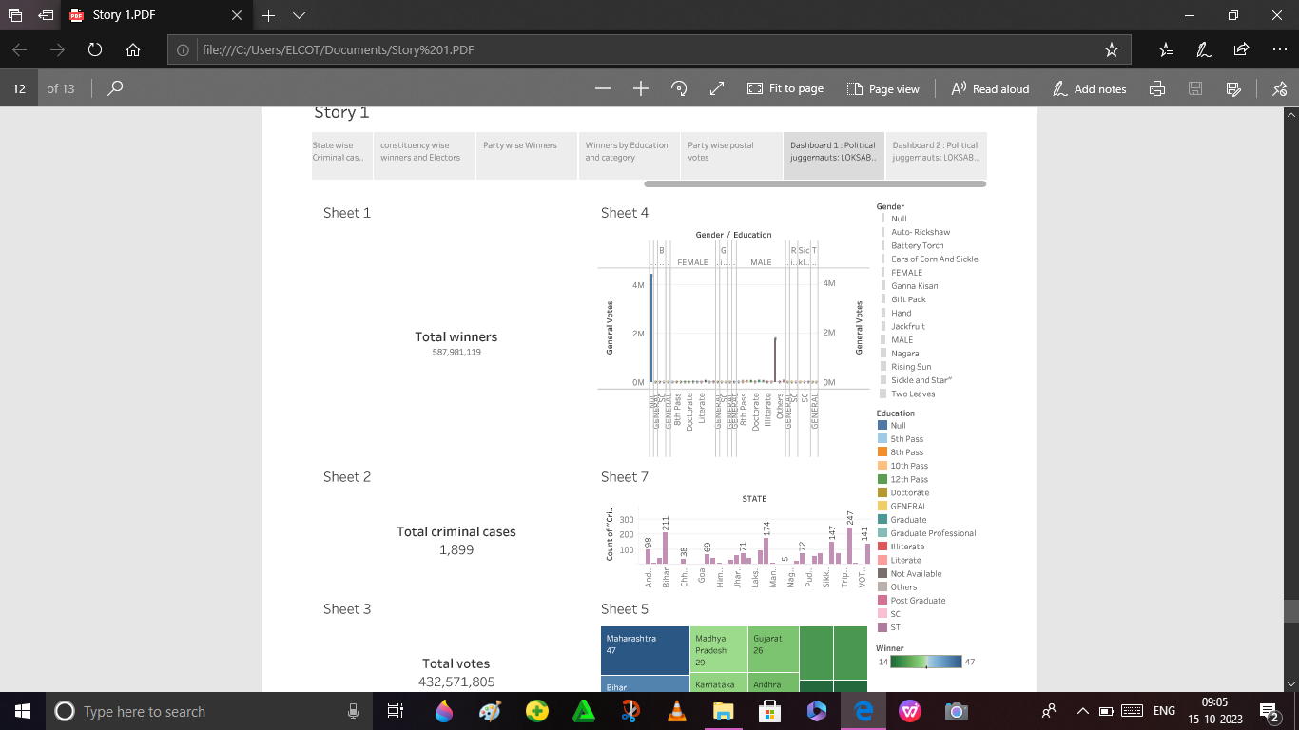
11.STORY CREATED
story created same procedure of dashboard created
Example : Activity :1 to Activity : 9 and added the Dsahboard’s
created the story one by one sheets with captain and added to Dashboard 1 and 2
Story was created

Slide 16
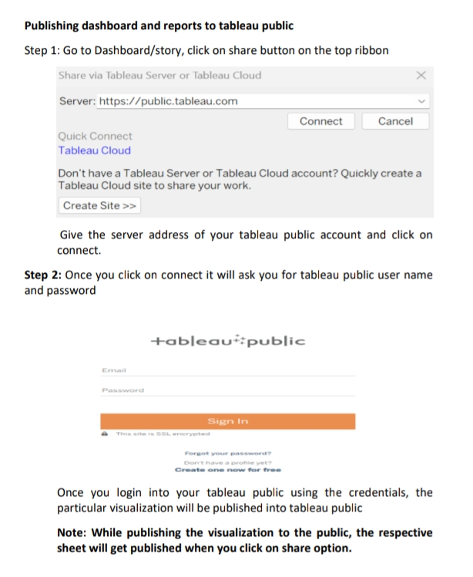
12. Tableau public created
open in sever and used to the link of https://public.tableau.com and connected.
created the User Name and Password.
created the account for tableau public.
Then share to the Dashboard 1 and 2, and Story into the Tableau publishing Server.
uploaded to the public
Then copy to the final link , and check to the proflie.

Slide 17
13.APPLICATION & CONCLUSION
political theory helps bureaucrats, politicans,government officers and advocates to interpret the laws and constitution.
FUTURESCOPE: A POLITICAL ANALYSIS can find work in different government offices and in private sector organisations as well.
recap the main points of your arguments , recalling (very briefly) how it challenges or supports the author you are discussing.
------------
THANKYOU

